Slide 1
Learning science
AKAL ACADEMY MANOLI SURAT

Slide 2
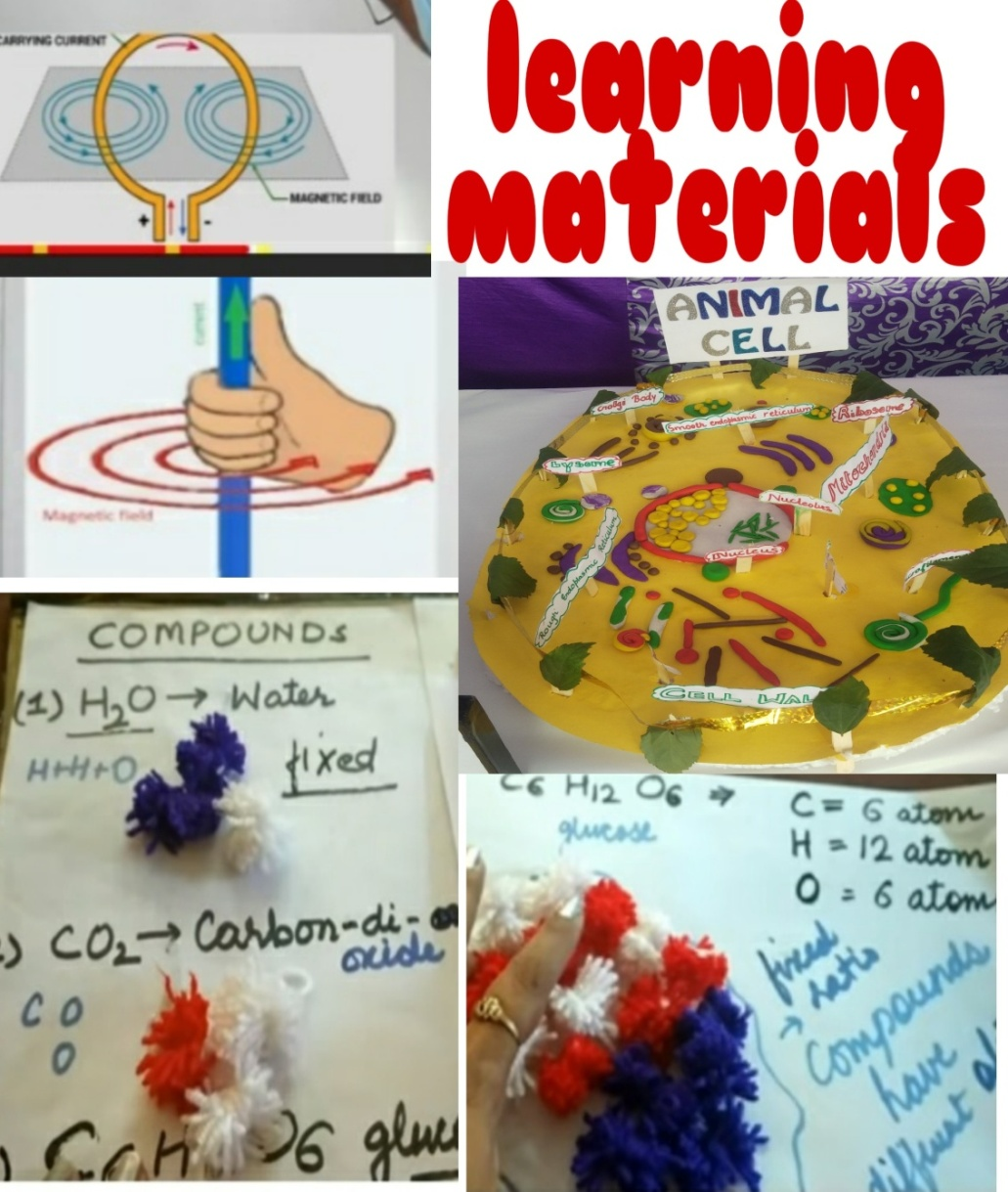
Learning materials in teaching are crucial to the success of student achievement

Slide 3
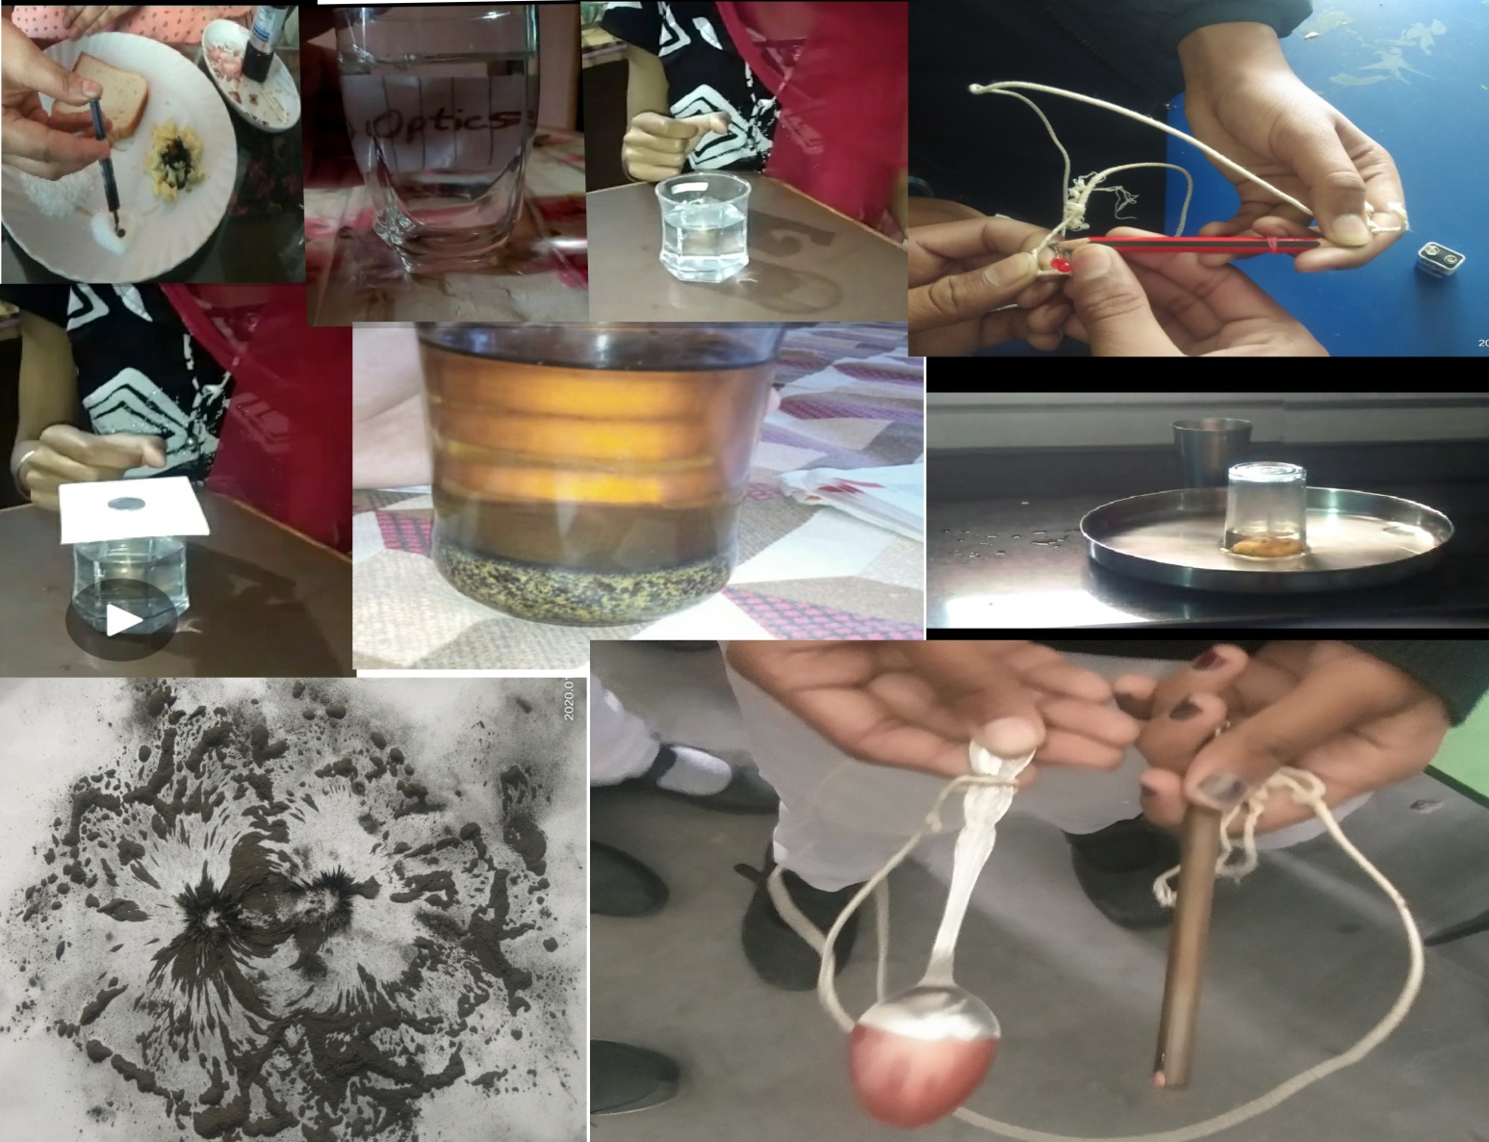
ACTIVITY BASED LEARNING

Slide 4
PROMOTE ENVIRONMENTAL AWARENESS

Slide 5
WORKSHEETS AND HANDOUTS

Slide 6
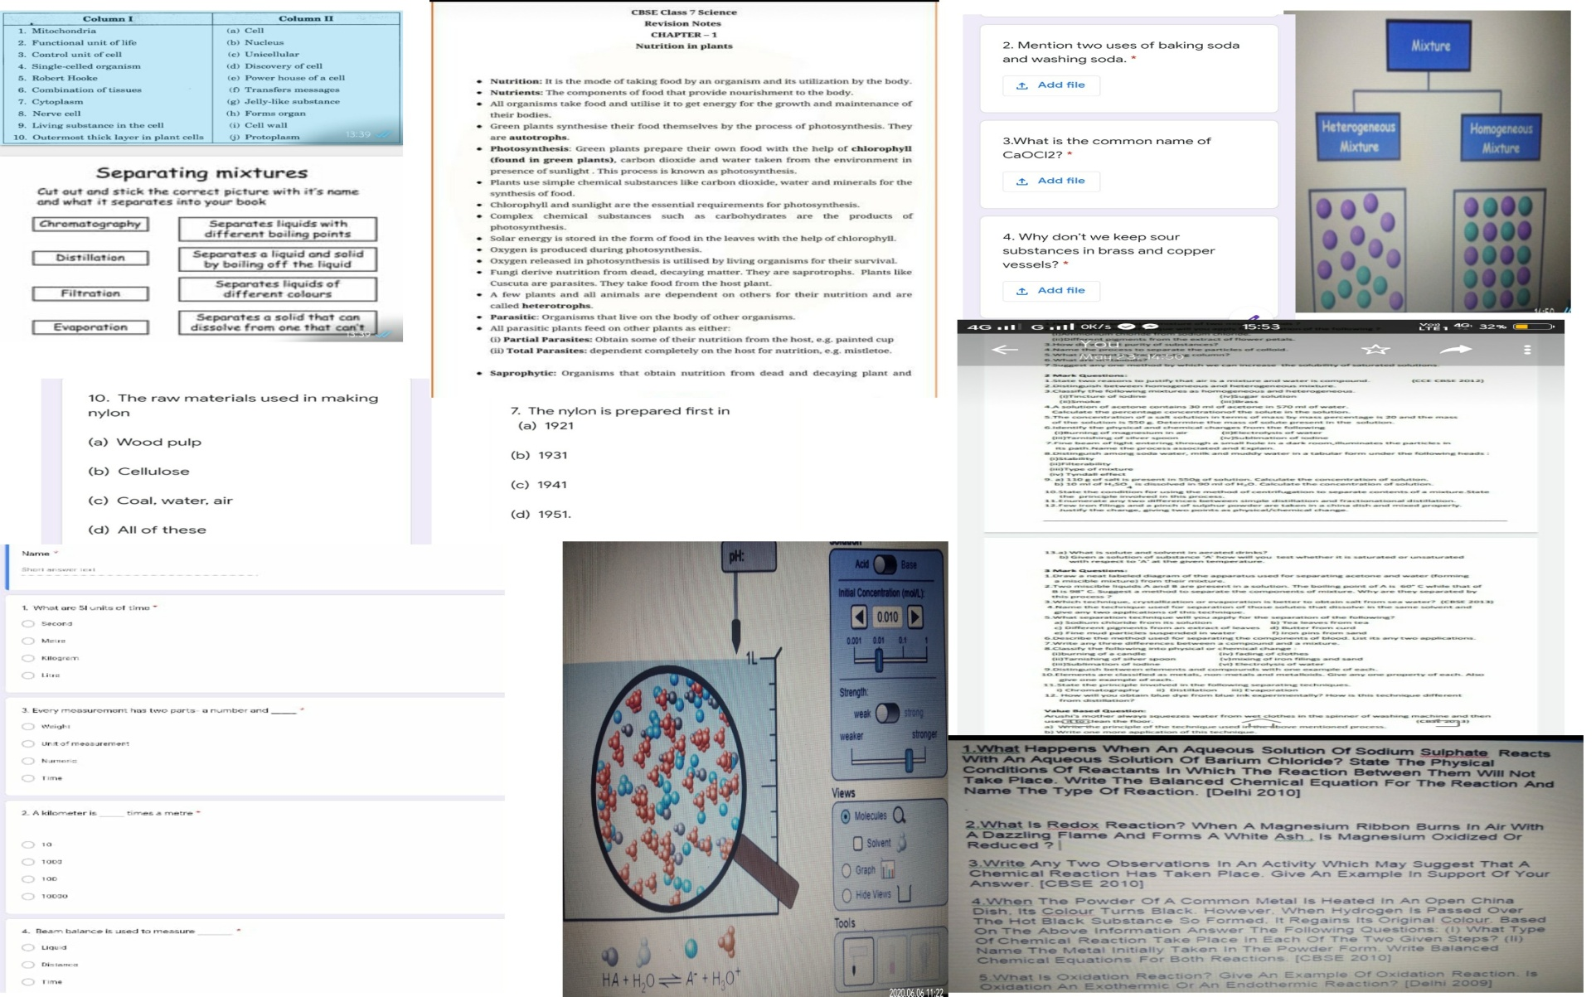

Slide 7
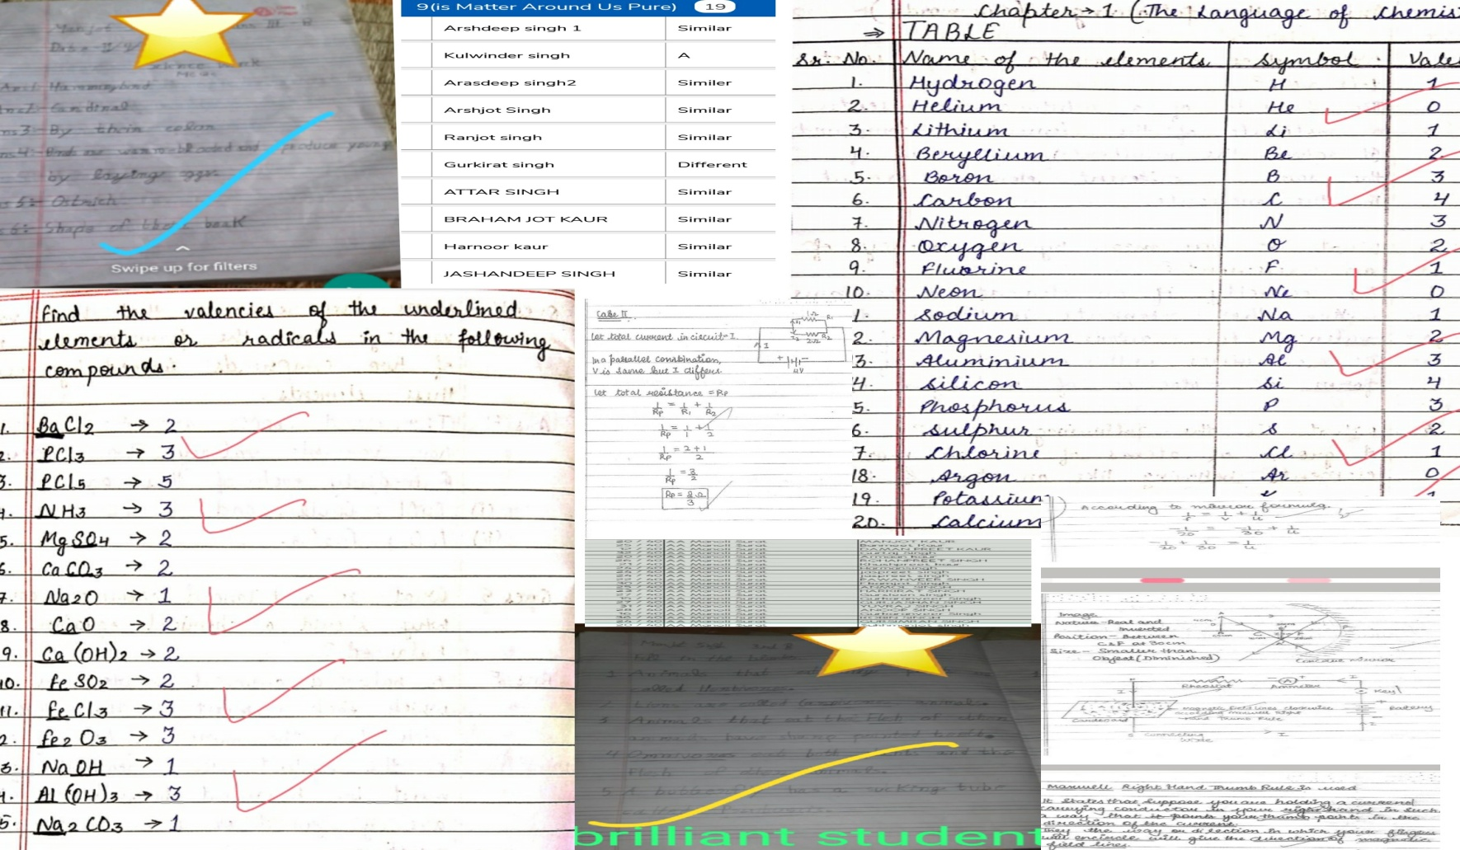
CHECKING OF ASSIGNMENTS

Slide 8
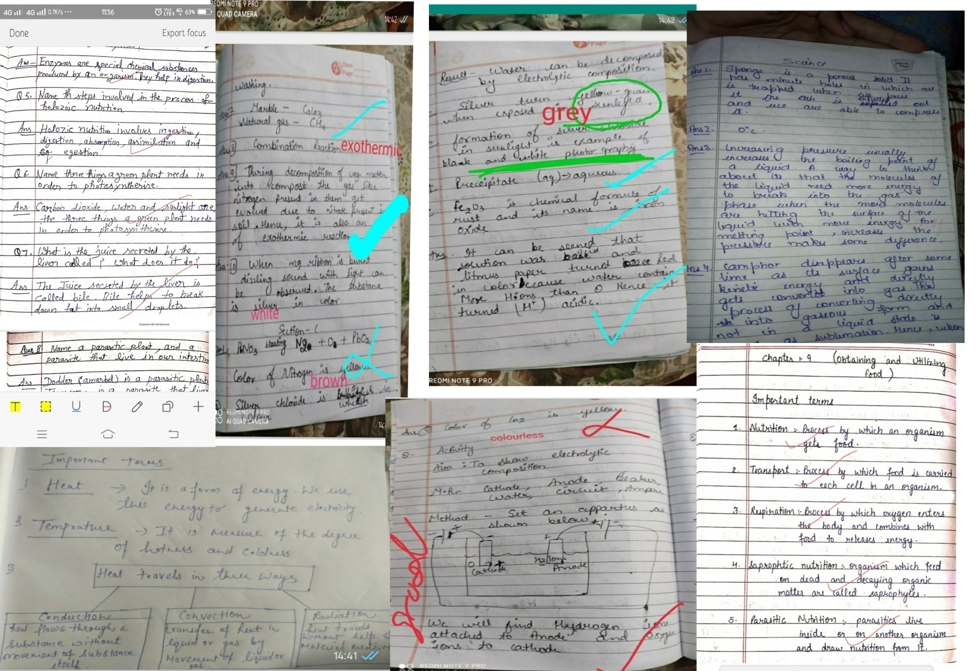

Slide 9
THANK
YOU

